Slide 1
Transformations
Investigating the Quilt Codes of the Underground Railroad

Slide 2
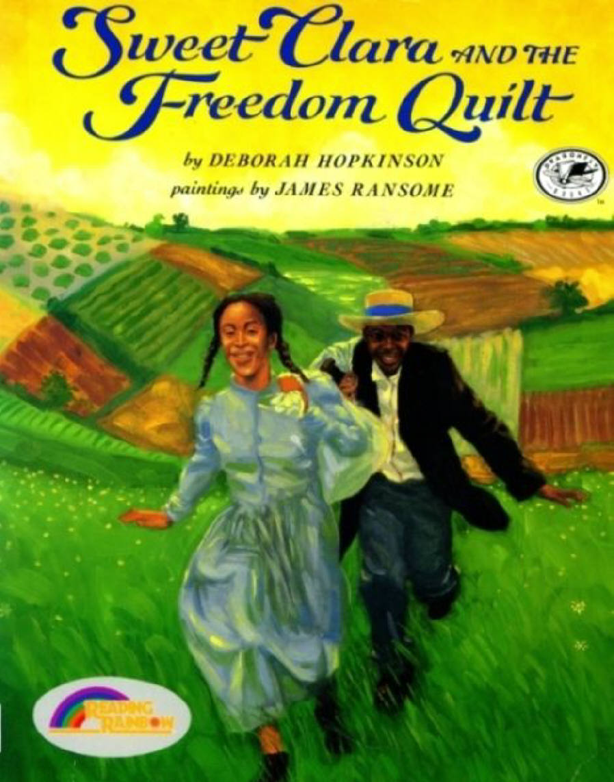
Read: Sweet Clara and The Freedom Quilt
As a seamstress in the Big House, Clara dreams of a reunion with her Momma, who lives on another plantation--and even of running away to freedom. Then she overhears two slaves talking about the Underground Railroad. In a flash of inspiration, Clara sees how she can use the cloth in her scrap bag to make a map of the land--a freedom quilt--that no master will ever suspect.

Slide 3
Choose a Quilt codes
http://www.osblackhistory.com/quiltcodes.php
Use GSP to construct the Quilt Code
Be sure your Quilt Square is Constructed
Maintains the properties
Keeps the symmetry
What transformations do you see that formed this symmetry?
Mirror lines?
Angles of Rotation?
Centers of rotation?
Vectors of Translation?

